Slide 1
Scientific Mehtod day 3 notes

Slide 2
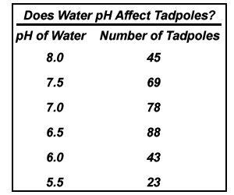
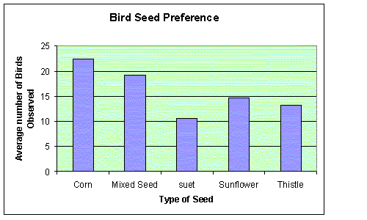
Test the Hypothesis? That’s Science
Design the Test:
Manipulate the Independent variable
Assess impact on dependent variable
In Hypotheses:
IF (independent Variable)
THEN (dependent variable)
In Tables:
Left-most column of table
In Graphs:
Independent
variable
X- axis of graph

Slide 3
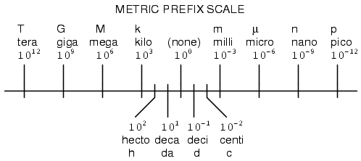
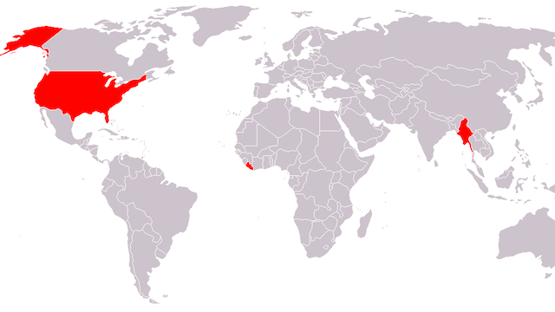
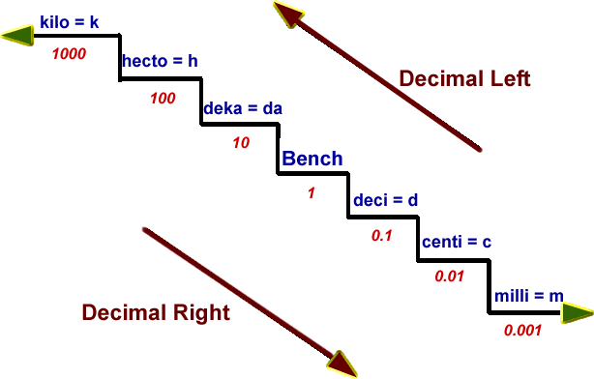
Measure the Data in SI
UNITS
yard meter
ounce gram
quart liter
PREFIXES
X 1/10 bigger unit
‘we don’t need no stinkin’ metrics’
X 10 smaller unit

Slide 4
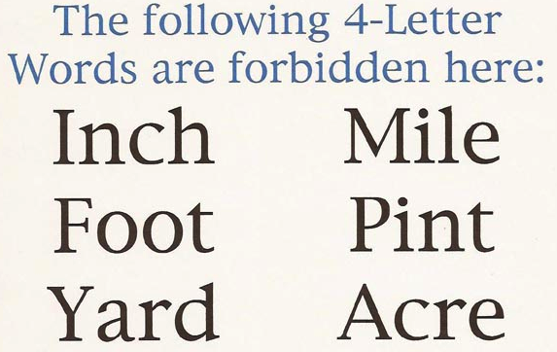
No Cussing!
Also, no f-bombs: (fahrenheit)
keep it clean
keep it metric

Slide 5
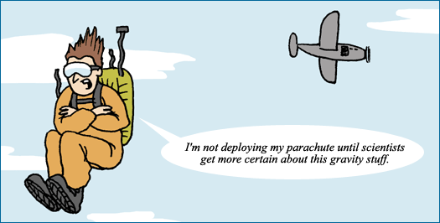
‘Just’ a theory?
-A scientific theory is an
overarching explanation of
natural phenomena
-Explains why whereas Laws
predict what will happen
-It is the result of a large body of evidentiary facts, a large number of scientists over a large number of years
-Is the current best explanation of the facts; is open to modification if a new explanation is better at explaining and predicting observations
Notes:
Image source: http://evolution.berkeley.edu/evolibrary/teach/68pitfalls.php

