Slide 1
Scientific Method Notes Day 3

Slide 2
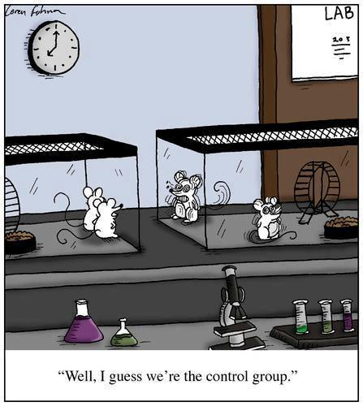
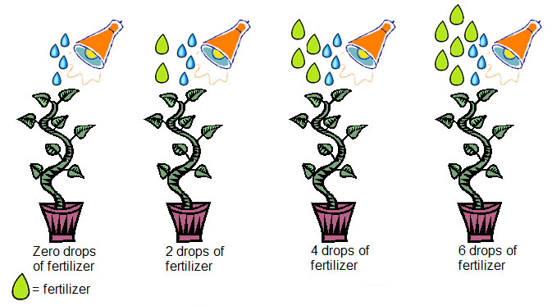
Experimental vs Control Groups
Control Group- NO change to IV for comparison-0 drops
Experimental Groups-IV changed to test hypothesis-2, 4, 6 drops

Slide 3
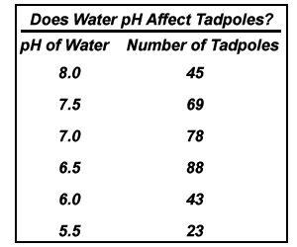
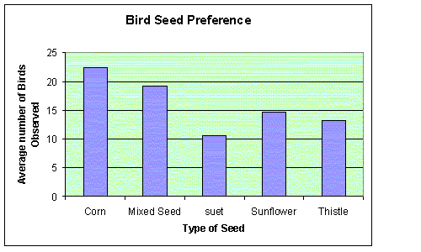
Test the Hypothesis? That’s Science
Design the Test:
Manipulate the Independent variable
Assess impact on dependent variable
In Hypotheses:
IF (independent Variable)
THEN (dependent variable)
In Tables:
Left-most column of table
In Graphs:
Independent
variable
X- axis of graph

