Slide 1

Uneven Heating of Earth causes climate
Not all places …
GET the same amount of sunlight
ABSORB the same amount of light
RETAIN the same amount of heat
www.bewellbuzz.com

Slide 2
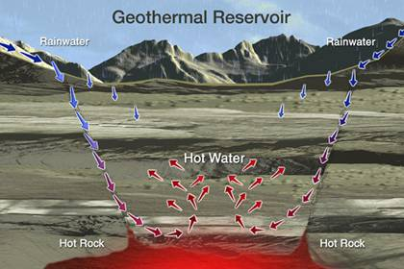
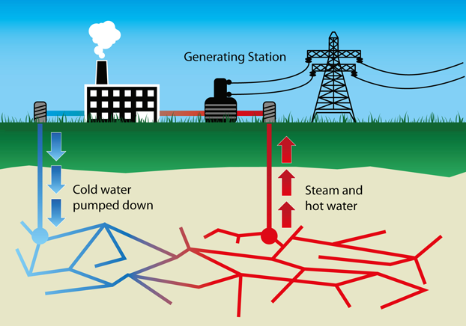
Energy Sources…
Geothermal = ~ 10% Earth’s energy from INSIDE earth due decay of radioactive atoms
Drives movement of crust (tectonics/EQ) and can be used to generate electricity (The Geysers!)

Slide 3
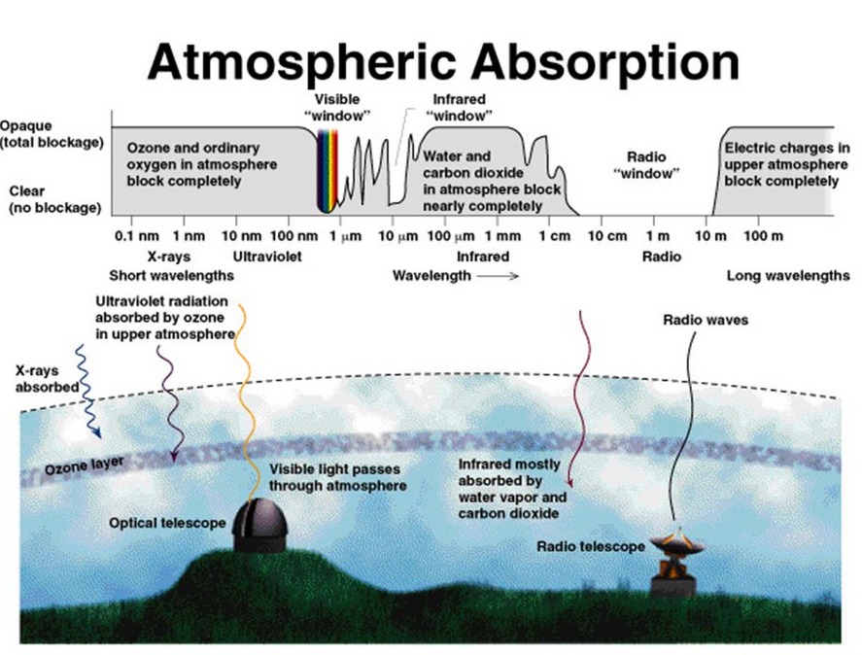
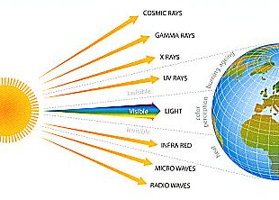
Solar Energy= Sunlight is ~90% of our available energy resources
Most solar energy is blocked by atmosphere

Slide 4
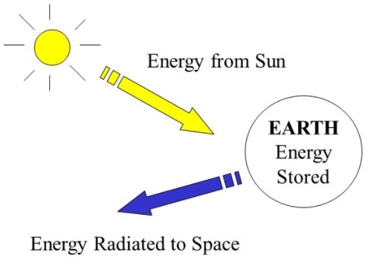

Of the 100% incoming solar energy, only 1% of it captured but it runs 90% of our energy processes
-Wind (heated air)
-Water cycle (evaporation)
-Plant photosynthesis (fossil fuels)
100%
1%
99%
Hydroelectric power video

Slide 5






The amount of that hits of Earths surface
in 1 hour
Is > than the amount of energy
used by all people
in a year.
The amount of sunlight
1 m³

Slide 6
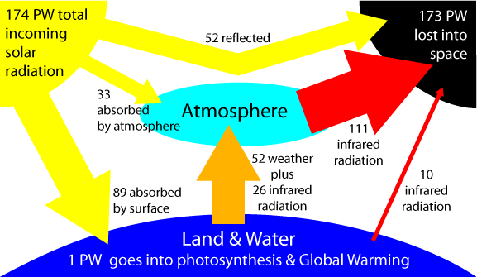
The Ins & Outs of Solar Energy
99%
30%
20%
50%
http://earsi.com/ggp01.htm
Notes:
1PW=1petawatt=
1x10¹⁵=1,000,000,000,000,000 watts

Slide 7
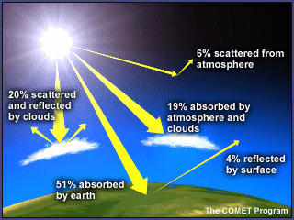
Entering sunlight is…
Reflected by clouds, atmosphere, surface, particles in atmosphere (pollution, dust, ash)
Absorbed by atmosphere (ozone) or clouds
Absorbed by surface (50%) & reradiated as heat
Amount absorbed by surface/yr > than 2x all the energy in fossil fuels ever
Plants only absorb < 0.1% of energy/yr

Slide 8
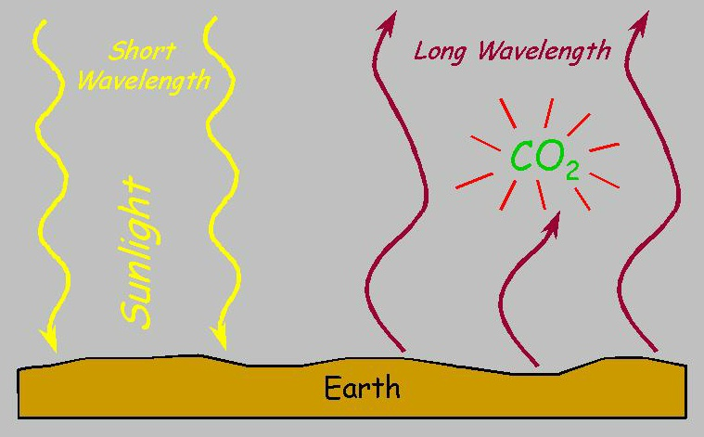
In effect, the sun heats the Earth…
…and the Earth heats the air, as terrestrial radiation is absorbed by greenhouse gases
CH₄
H₂0
absorbed solar radiation terrestrial radiation

Slide 9
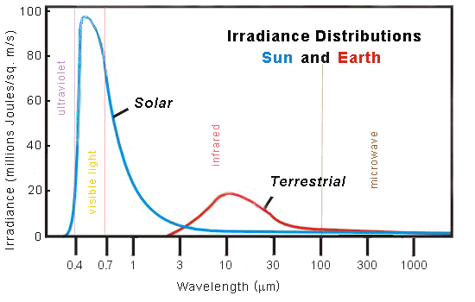
solar radiation
terrestrial radiation
• shorter wavelength
visible EMR
• absorbed by land, water
• absorbed solar radiation re-radiated back from Earth
• longer wavelength
infrared (heat) EMR
infrared

Slide 11
Recall …
Different materials have different specific heat capacities (amount of energy absorbed to raise temp of 1 gram by 1C)

Slide 12
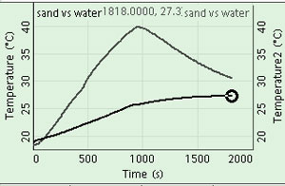
Water has a higher specific heat/slow to warm and cool
sand
water
By inference, land heats & cools quickly; oceans do not

Slide 13
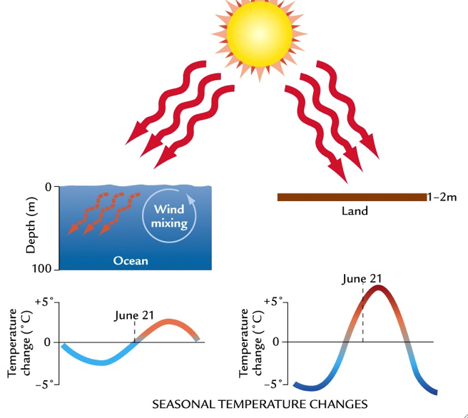
Therefore, daily and seasonal temperature depends on the surface
> High SHC
> Little variation in heat released
> Little seasonal temp change
> Low SHC
> Absorbs heat fast, loses it fast, too
> Great seasonal temp changes
coastal inland

Slide 14
Heating of the earth varies due to the angle between the sun rays and Earth’s surface

Slide 15
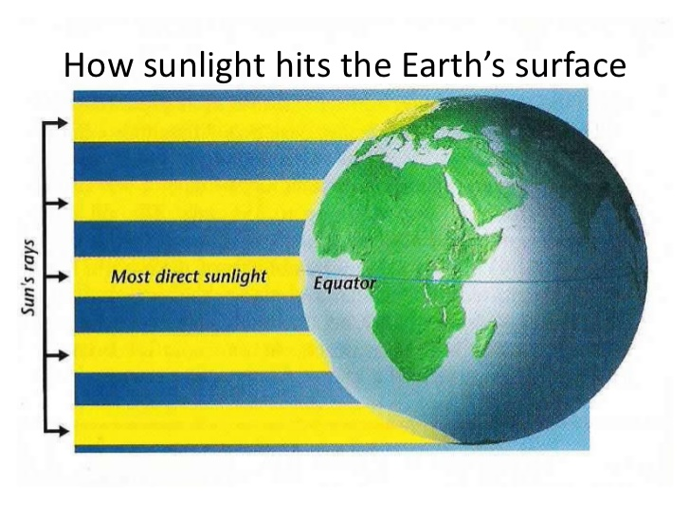
Earth’s spherical shape means light at the poles hits at a low angle and at 90 degrees overhead at the equator
Equal amounts of solar rays
Solar energy strikes Earth at the equator at 90 degrees, concentrating the energy on a small area
Radiant energy strikes the poles at a shallower
angle, spreading energy over a larger area
Less concentrated energy

Slide 16

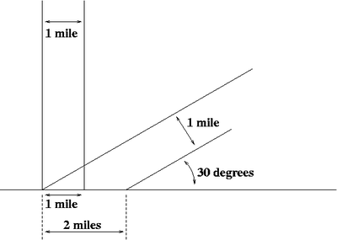
The same amount of solar energy that is directly overhead at the equator is spread over a greater area at the poles
90° angle
Earth surface
a shallower angle covers more area; less light per equal area
Notes:
1mi > 2 mi = 4x? Inverse square law!

Slide 17
Air temp varies due to the tilt of the earth on it’s axis

Slide 18
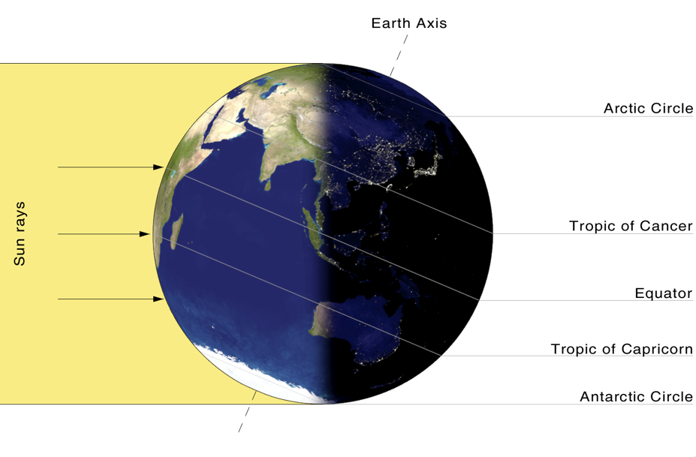
The axis angle is 23.5 degrees
long ‘night’ – 24 hours!
Effect: seasons!
• varying lengths of days and nights
• varying angle of solar radiation
Notes:
The Earth’s axis is tilted at an angle of 23.5° away from the plane of the ecliptic. And it’s because of this tilt that we have seasons here on Earth.
To better understand this, first we have to think of the Sun. Imagine there’s a line passing through the north pole and south poles of the Sun. This is the Sun’s axis of rotation. Then imagine a disk coming out from the Sun’s equator in all directions. This disk is called the plane of the ecliptic, and it’s where all of the planets in the System are located. Astronomers then measure the axis of rotation passing through each of the planets. The axial tilt of each planet is measured by the angle it makes compared to the Sun’s axis of rotation.
And so, in the case of our planet, the Earth’s axis measures 23.5° away from the Sun’s axis of rotation.
http://www.universetoday.com/47176/earths-axis/

Slide 19
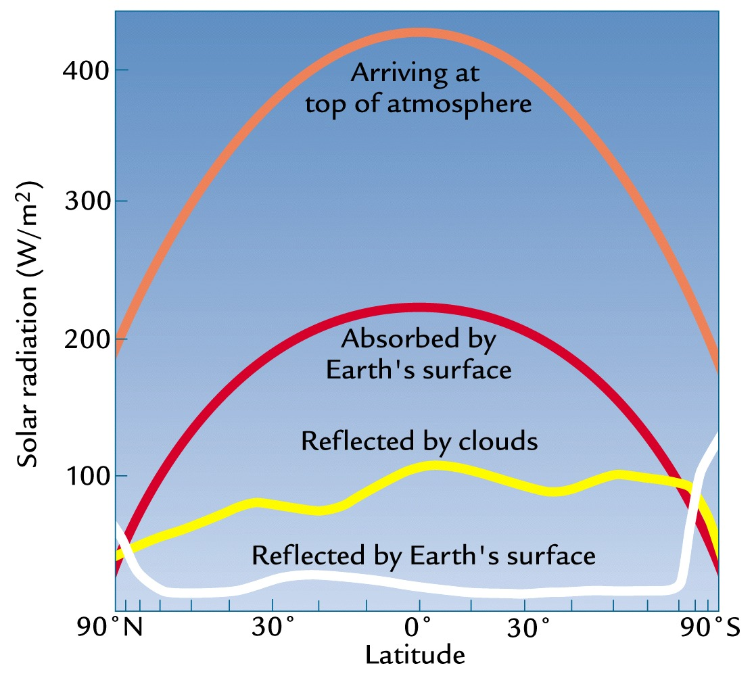
More insolation (incoming sunlight) at equator than poles
More reflection at the poles (snow/ice)
http://www.sonoma.edu

Slide 21
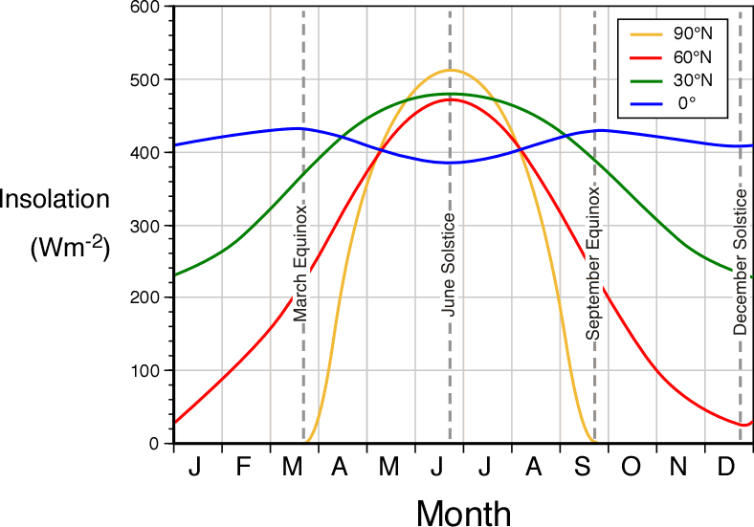

Slide 22
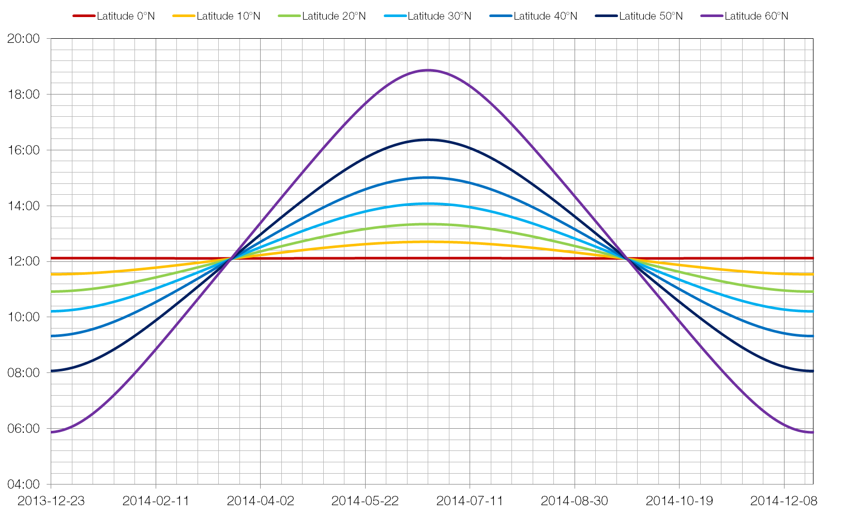
Changes to Length of Daylight hours by latitude.

Slide 23
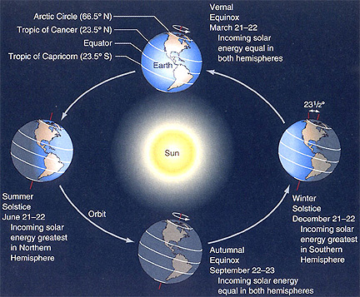
Northern Hemisphere tilted TOWARDS sun
SUMMER
Northern Hemisphere tilted AWAY FROM the sun
WINTER
Like the spherical shape, the tilt affects the angle & spread of the light
Don’t fall for this misconception: Earth is closer to the sun in summer
Fact: • Earth’s orbit is an ellipse
• farthest from the sun in June (1.6 million mi)
http://www.youtube.com/watch?v=O9hawBb3wbk

Slide 24
Heating of the earth varies due to the surface color

Slide 25
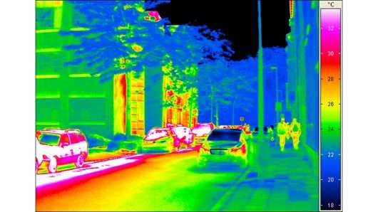
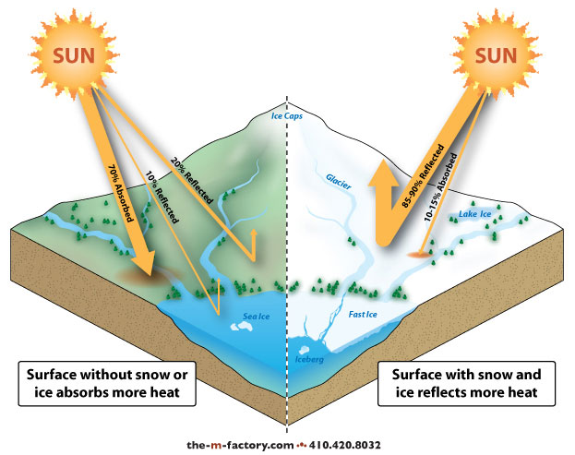
Light colors (snow/ice) reflects more-albedo
Dark colors (asphalt) absorb more-cities are ‘heat islands’

Slide 26
The result is an energy imbalance, which creates temperature, density, water vapor, and pressure imbalances

Slide 27
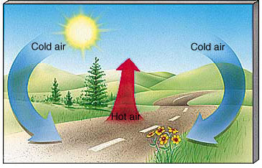
Differences in surface temp create differences in air temp
Circulation happens

Slide 28
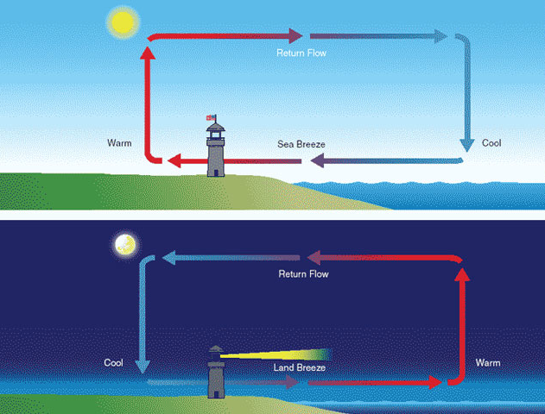
Effect: Localized Circulation
Warmed air:
greater energy
less dense
lower pressure
Air rises
A summer day
Onshore winds
Cooling air :
losing energy
more dense
higher pressure
Air sinks
A summer night
Offshore winds
Notes:
Small scale video example

Slide 29
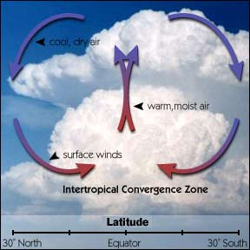
Effect: Global Circulation
At altitude it cools and sinks
Cooler air holds less water vapor, clouds form
Heated air is less dense, rises
Creates vertical air flow

Slide 30
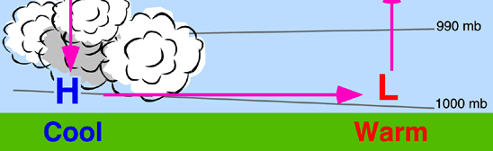
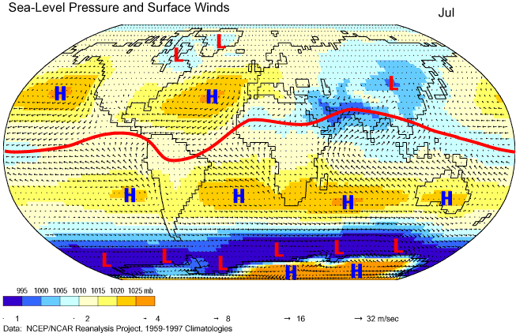
Effect: variations in pressure
rising = low
sinking = high
Effect: Global regions of high and low pressure

Slide 31
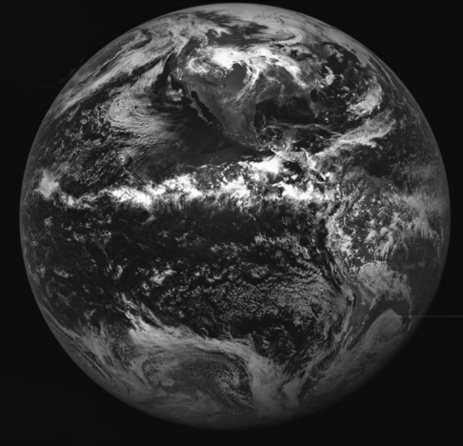
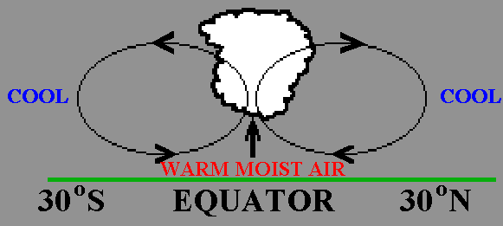
Effect: Planet-wide bands of clouds
here
Notes:
Add a video of equatorial clouds!

Slide 32
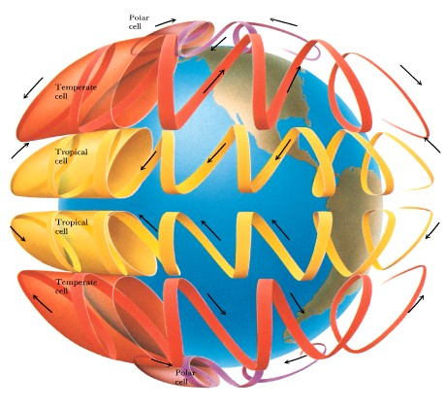
Global convection creates not one big 0 – 90 degree cell, but a set of three N and S of the equator
The surface winds created by the convection cells do not flow N-S as expected
WHY?

Slide 33
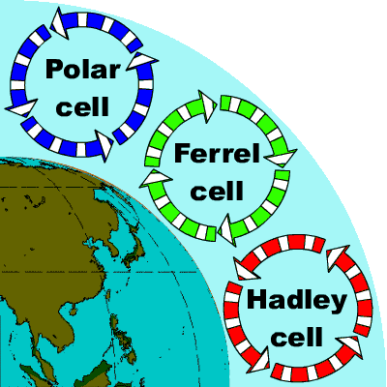
Effect: A set of convection cells are
created every 30 degrees of latitude
Notes:
Add video

Slide 34
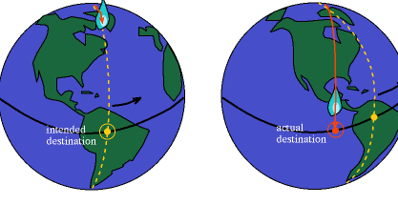
As the spherical Earth rotates on it’s axis, different latitudes rotate at different speeds.
N-S bound objects not tied to the surface – like air, or a plane – have a constant speed, and so although moving straight, appear to be on a curved path.
CORIOLIS EFFECT
Notes:
Add video
The Earth rotates to the east at an effectively constant angular velocity, but different latitudes have different linear speeds. A point at the equator has to go farther in a day than a point in Ohio, so it must go faster.
objects moving north or south and not firmly connected to the ground (air, artillery fire, etc) maintains its initial eastward speed as it moves. An object leaving the equator will retain the eastward speed of other objects at the equator, but if it travels far enough it will no longer be going east at the same speed the ground beneath it is.
The result is that an object travelling away from the equator will be heading east faster than the ground and will seem to be forced east by some mysterious force. Objects travelling towards the equator will be going more slowly than the ground beneath them and will seem to be forced west. In reality there is no actual force involved, the ground is simply moving at a different speed than the object is "used to".
The equator has the greatest rotation – further distance to cover, so greater speed – and so most pronounced Coriolis effect

Slide 35
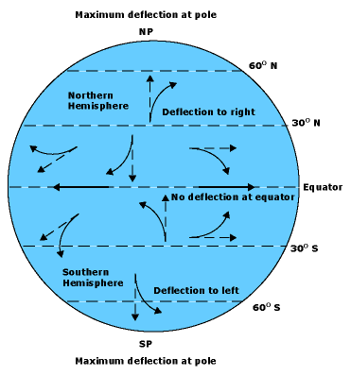
Effect: Winds appear deflected…
…to the right in the
northern hemisphere
…to the left in the southern hemisphere
Notes:
https://www.youtube.com/watch?v=Wda7azMvabE
https://www.youtube.com/watch?v=i2mec3vgeaI
https://www.youtube.com/watch?v=_36MiCUS1ro

Slide 36
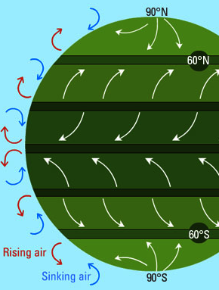
Energy imbalance + Coriolis = Global winds
the N/S horizontal aspect of each convection cell creates E/W air flow (wind)
In contrast, regions of vertical flow have little wind

Slide 37
Polar
Ferrel
60
30
0
30
60
Hadley
Doldrums
Tradewinds
Horse latitudes
Westerlies
Polar easterlies

Slide 38
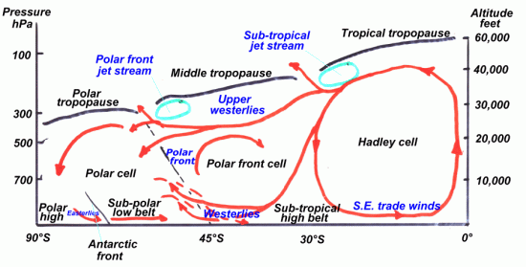
Well, maybe not so simply….

Slide 40
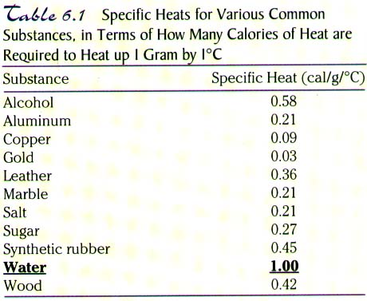
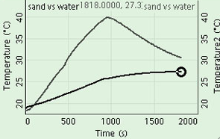
Heating by solar absorption varies due to…
Surface material specific heat capacity
Water has a high specific heat (amount of energy absorbed to raise 1 gram by 1⁰ Celsius)
sand
water

Slide 41
Therefore, daily and seasonal temperature depends on the surface
> High SHC
> Little variation in heat released
> Little seasonal temp change
> Low SHC
> Absorbs heat fast, loses it fast, too
> Great seasonal temp changes
coastal inland
Moderating Climate Demo

Slide 42
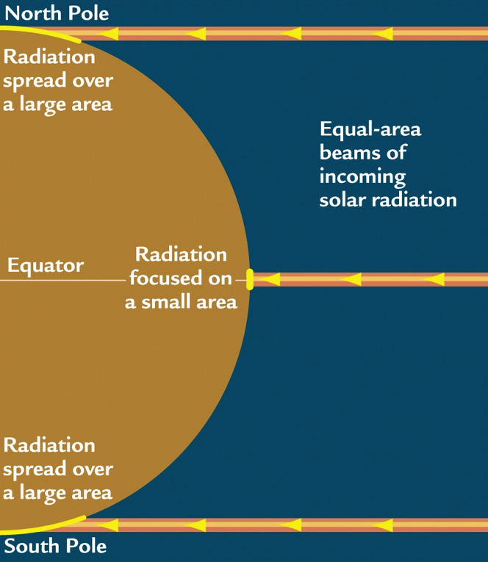
Angle of Light
• Earth-Sun geometry (it’s a sphere!) leads to differences in air temperature
> Radiant energy strikes Earth at the equator at 90 degrees, concentrating the energy on a small area
>Radiant energy strikes the poles at a shallower
angle, spreading energy over a larger area

Slide 43
The same amount of solar energy that is directly overhead at the equator is spread over a greater area at the poles
90° angle
Earth surface
a shallower angle covers more area; less light per equal area
Notes:
1mi > 2 mi = 4x? Inverse square law!

Slide 44
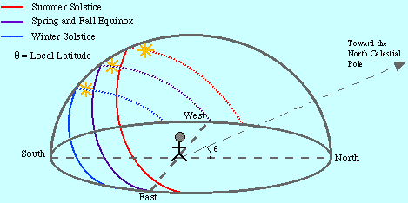
Length of Day
Summer-When Earth is tilted toward sun; the sun’s path is higher = longer day
Winter-Earth is tilted away from sun; sun’s path is lower and day is shorter

Slide 45
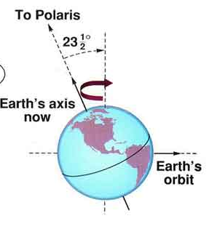
Length of Day
Earth’s tilt is 23.5⁰
Tilt stays constant during the revolution around the sun
Results in times when the tilt is pointed toward or away from the sun during the year
Northern
Hemisphere
Southern
Hemisphere

Slide 46
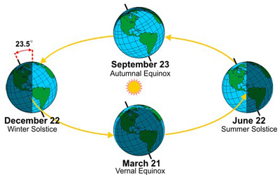
In December…
N. Hemisphere -tilted away from sun (light spread out)
S. Hemisphere -tilted toward sun (light concentrated)
Equator? never tilted toward or away (one season)
Equal night
Longest day
Shortest day
Midnight Sun Alaska
Planetary View (mute)
Notes:
Equinox=equal night (12hr day and 12hr night)

Slide 47
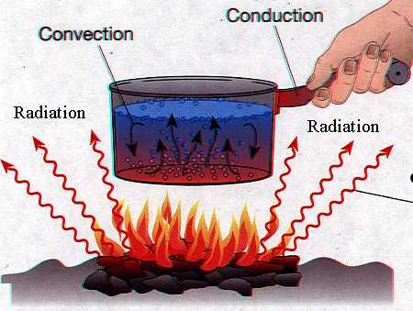
Heat Transfer occurs by…
Radiation- UV/Visible light absorbed by Earth’s surface
Conduction- The surface is in direct contact with the air above
Convection- Moving air distributes heat

Slide 49
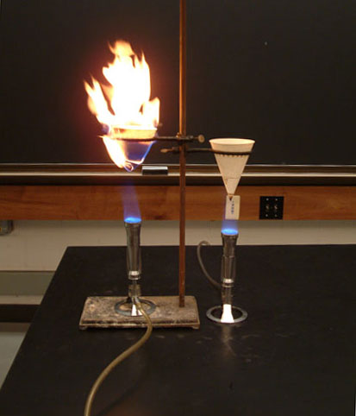
What?

Slide 50

Not all surfaces absorb heat equally
Land heats more quickly than water
Land ? Or water?

Slide 51

Specific heat is the amount of energy required to raise the temperature of 1g of material by 1⁰C.
Examples-
metals heat quickly (copper 0.09 cal/g) and water heats slowly (1.00 cal/g)
Notes:
Cool tea with a metal spoon that has a low specific heat (absorbs heat quickly—not much energy required to change the temp).

Slide 52
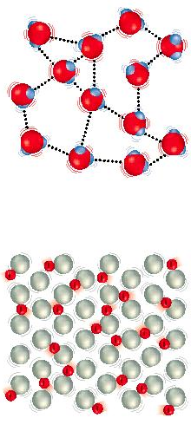
Why does water have such a high specific heat (high heat capacity)?
Water
Water’s hydrogen bonds of attraction take more energy to pull apart
Metals have weak bonds are do not take much energy to pull apart
Metal

Slide 53
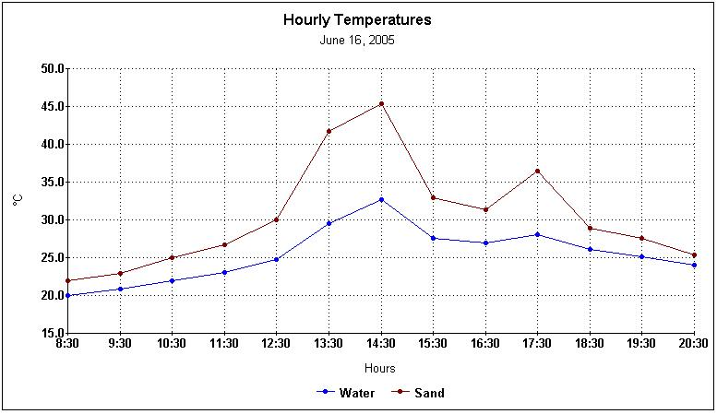
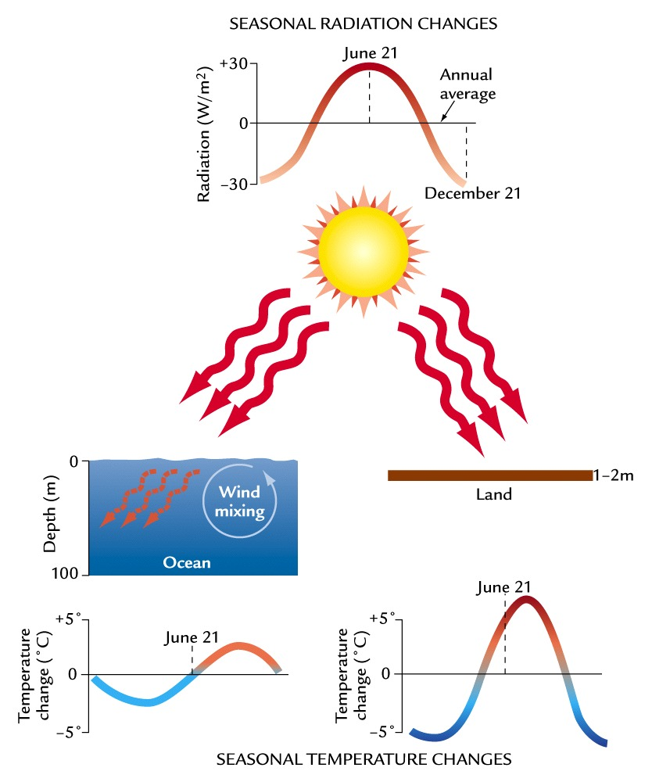
Oceans moderate temperature change
Moderating Climate Demo

Slide 54
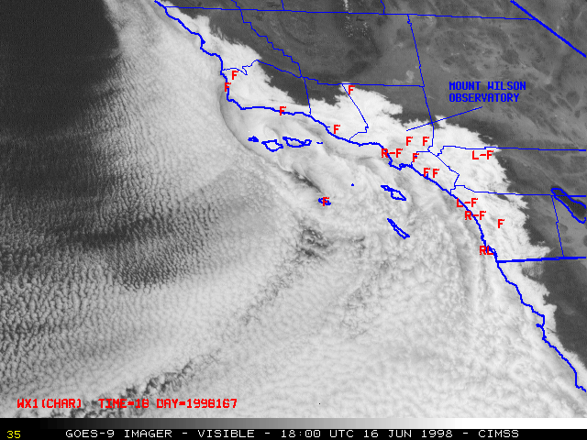

All those H bonds means temp changes are slow;
Oceans moderate climate
Ex: cool CA current;
warm Caribbean climate
Ocean currents influence air temp, which blows over landmasses
Notes:
Water has thermal inertia.
Ocean off CA influences the land more than the Atlantic does on the East coast due to the direction (W to E) of the prevailing winds.
54

Slide 56
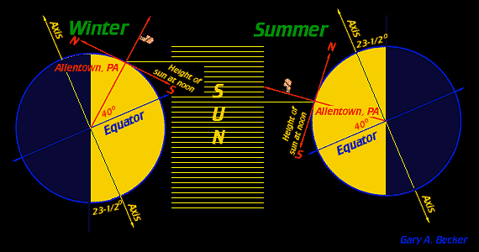
Angle & Intensity of Sun
Summer-tilted toward
Sun higher in sky 90⁰-direct light
more sun rays per square inch (hotter)
Winter-tilted away
Sun lower in sky <90 –light spread out
Fewer sunrays per square inch (cooler)
Notes:
Note the flag on the red line. The sun angle is closer to the flag pole (and thus higher in the sky) during summer

Slide 57
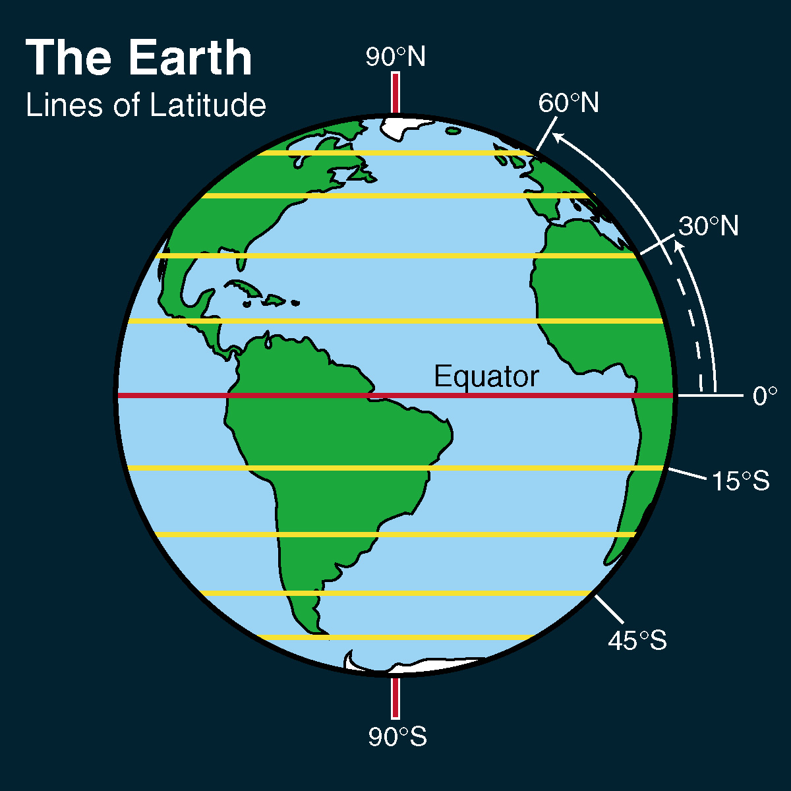
Light angle varies with latitude
Equator receives more direct, concentrated rays/cm²
Poles receive less direct, less concentrated rays/cm²
http://www.sonoma.edu

