Slide 1
Genetic Trait Wheel
Survey of Human Mendelian Dominant and Recessive Traits

Slide 2
Essential Question: What traits did we inherit from our parents and how are we affected by them?
Record the essential question at the bottom of the broccoli article.
What is the most important part of this question for you?
Notes:
PTC info source w/ audio links
https://learn.genetics.utah.edu/content/basics/ptc/

Slide 3
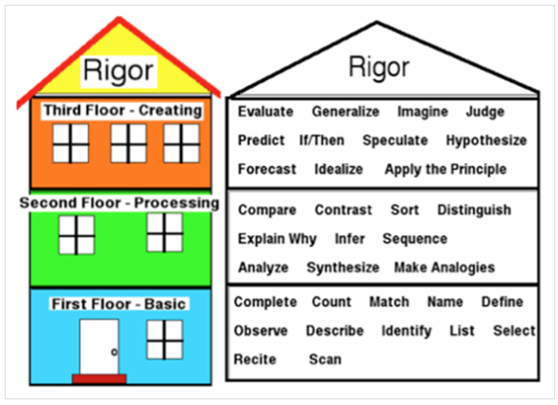
Costa’s Levels of Questioning

Slide 4
Broccoli Article
How do you feel about broccoli and why? (answer at top)
Number the paragraphs (#1 =title)
Circle unfamiliar vocab as you read
Highlight information that answers the essential question.
In margin come up with three questions of your own (one from each level)
Essential Question: What traits did we inherit from our parents and how are we affected by them?

Slide 5
Human Trait Pre-Survey Questions
Do you think you look more like your mom or your dad? Why?
Do you think you have more dominant or recessive traits? Why?
Do you think dominant traits or recessive traits are more common in the Windsor population? Why?
Do you think there are any regions where dominant or recessive traits are more common (Africa, Asia, South America, Europe)?

Slide 6
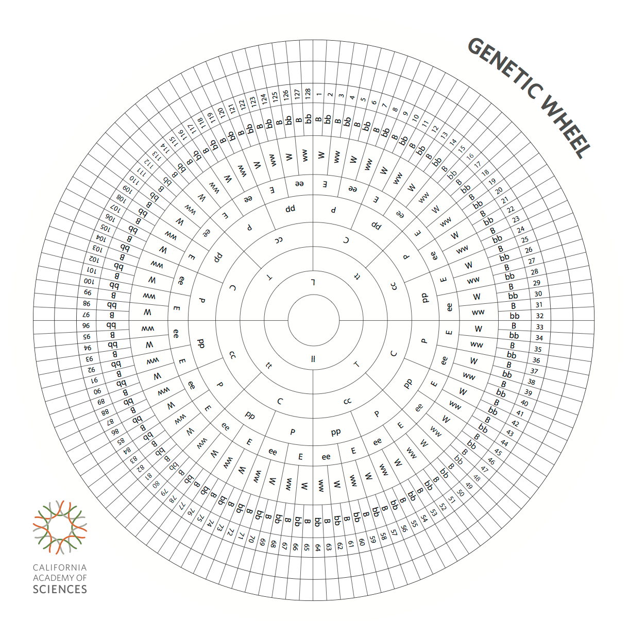
Trait | My Phenotype | My possible Genotype
Laugh Dimples L=with
Tongue roll T=roller
Crossing Thumbs C=left on top
Pinkies P=bent
Earlobes E=free
Widow’s Peak W=with
Hitchhikers Thumb B=straight
PTC Tasting T=Taster
Polydactyly D=6 d=5

Slide 7
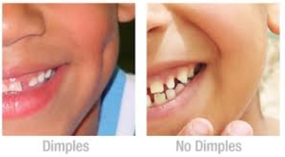
Human Traits
The following are considered to be single gene traits—expressions of
various combinations of two alleles at one gene locus.
Laugh dimples
DIMPLES -DOMINANT NO DIMPLES- RECESSIVE
L dimples
LL Homozygous dominant or
Ll Heterozygous
ll no dimples
Homozygous recessive

Slide 8
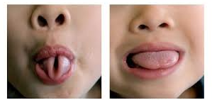
Tongue roll
ROLLER- DOMINANT (T) NON-ROLLER –RECESSIVE (t)
T can roll tongue into “U” shape TT homozygous dominant or
Tt heterozygous
tt can’t roll tongue into “U” shape homozygous recessive

Slide 9
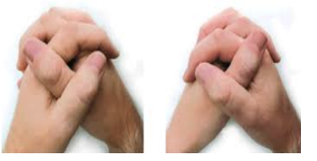
Crossing Thumbs
LEFT- DOMINANT (C) RIGHT – RECESSIVE (c)
C left thumb on top of clasped hands
CC Homozygous dominant
Cc Heterozygous
cc right thumb on top of clasped hands
Homozygous recessive

Slide 10
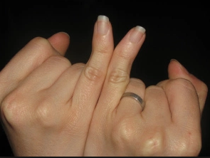
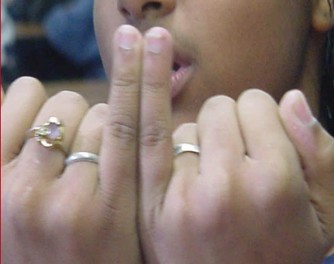
Pinkies
BENT- DOMINANT (P) STRAIGHT – RECESSIVE (p)
P pinkies bend away from each other, toward the ring fingers, when pressed side by side
PP Homozygous dominant
Pp Heterozygous
pp pinkies are straight when pressed side by side Homozygous recessive

Slide 11
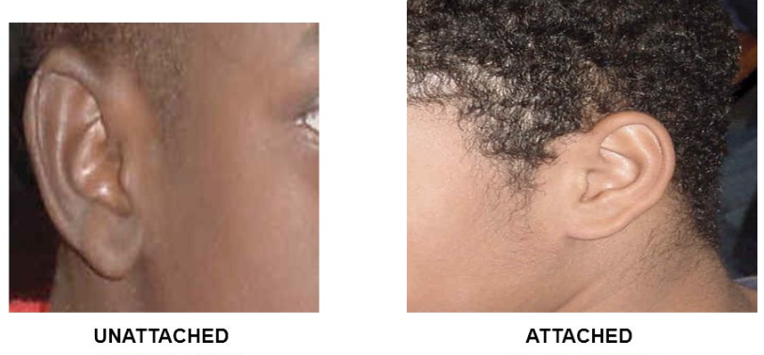
Ear lobes
FREE- DOMINANT (E) ATTACHED – RECESSIVE (e)
E free ear lobe
EE Homozygous dominant or
Ee Heterozygous
ee attached ear lobe Homozygous recessive

Slide 12
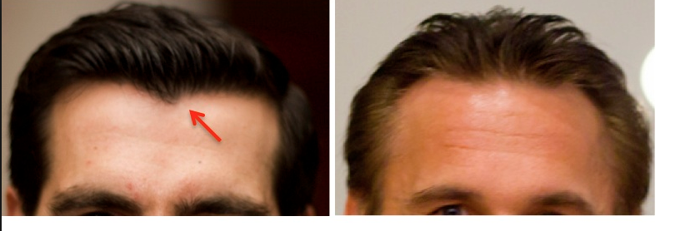
Widow’s peak
WIDOWS PEAK- DOMINANT (W) NO WIDOW’S – RECESSIVE (w)
W has a widow’s peak
WW Homozygous dominant or
Ww Heterozygous
ww no widow’s peak
Homozygous recessive

Slide 13
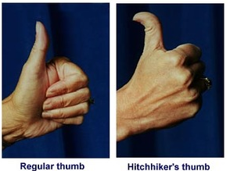
Bending thumbs (Hitch-hiker’s thumb)
STRAIGHT- DOMINANT (B) BENT- RECESSIVE (b)
B thumb is straight
BB Homozygous dominant
Bb heterozygous
bb thumb bends at 90 degree angle
Homozygous recessive

Slide 14
Trait | My Phenotype | My possible Genotype
Laugh Dimples L=with
Tongue roll T=roller
Crossing Thumbs C=left on top
Pinkies P=bent
Earlobes E=free
Widow’s Peak W=with
Hitchhikers Thumb B=straight

Slide 15
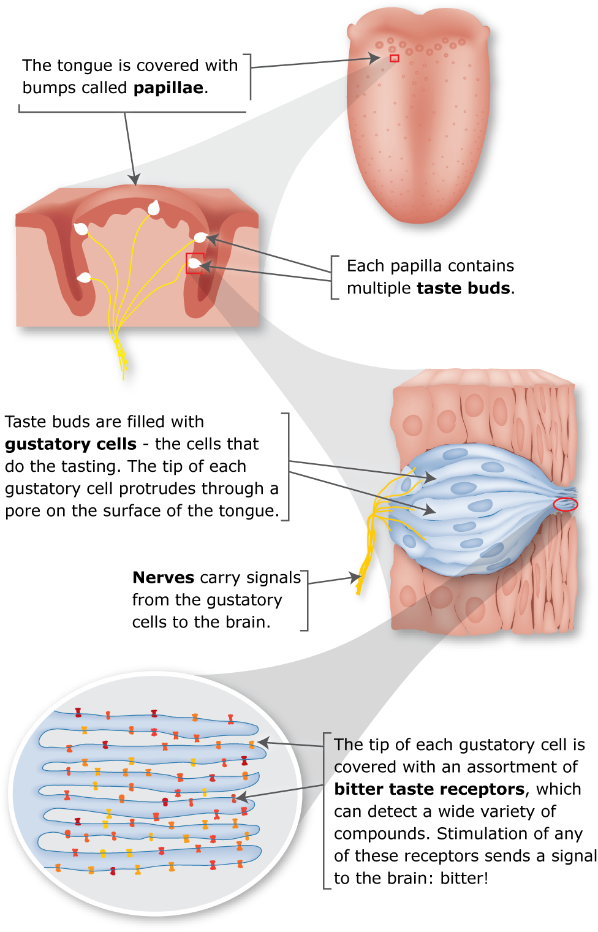
PTC (Phenylthiourea) Taster
In 1931, a chemist named Arthur Fox was pouring some powdered PTC into a bottle. When some of the powder accidentally blew into the air, a colleague standing nearby complained that the dust tasted bitter. Fox tasted nothing at all. Curious how they could be tasting the chemical differently, they tasted it again and tested family members.
T Taster
TT Homozygous dominant
Tt heterozygous
tt Non-taster
Homozygous recessive
Dr. Steve Wooding talks about the evolutionary importance of bitter taste.

Slide 16
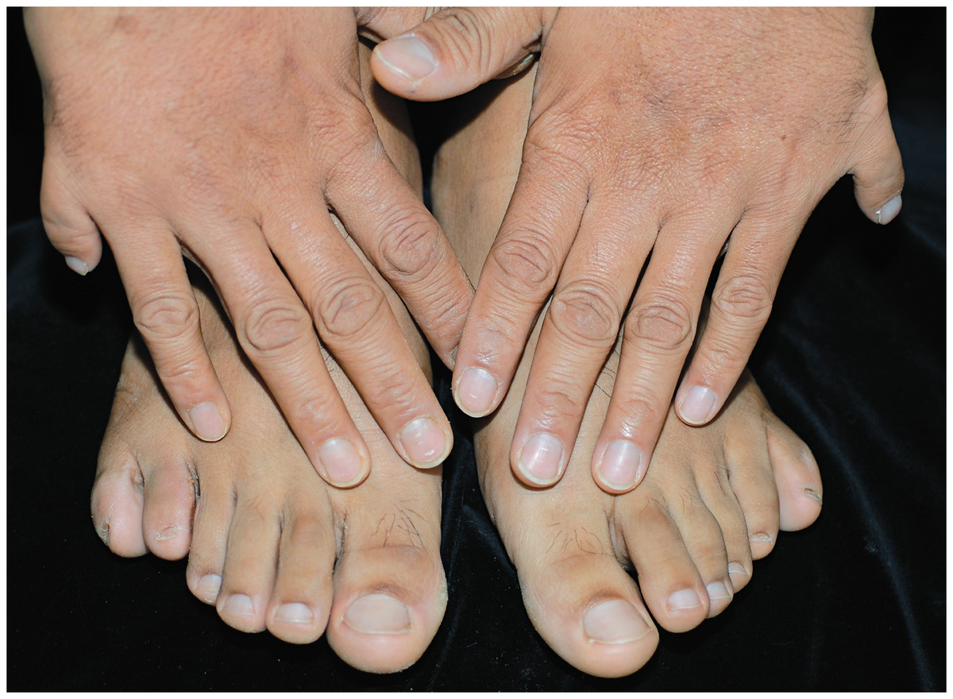
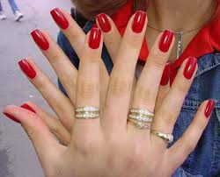
Polydactyly- having 6 fingers
6 FINGERS/TOES- DOMINANT (D)
5 FINGERS/TOES RECESSIVE (d)

Slide 17
Reflection
What traits did you inherit from your parents and how are you affected by them?
Do you have more dominant or recessive phenotypes?
3. Are dominant phenotypes always more common? (light hair, blue eyes and 5 fingers are recessive).
4. How might your PTC tasting gene affect how you experience foods?
5. What are your questions?

Slide 18
Glass and Kistler (1953) conducted a family study on 450 families. They decided that anyone with one or both thumbs having an angle equal to or greater than 50 degrees had the hitchhiker's thumb trait. From their study they collected the following data:
Parents S offspring H offspring Percent S
SxS 281 32 90%
SxH 71 37 66%
HxH 1 30 3%
2. Beckman (1960) also conducted a family study on the hitchhiker's thumb. His study used data from one hundred families that each had one child of about the age of three. His data are in the following chart:
Parents S offspring H offspring Percent S
SxS 50 8 86%
SxH 18 17 51%
HxH 3 4 43%
Conclusions:
Thumbs cannot be divided into just two categories: "hitchhiker" and "non-hitchhiker". From the picture below it's clear that there is a whole spectrum of thumbs between the two categories. While some thumbs cannot bend at all, others can bend well past 90 degrees. While there is probably some genetic influence on the hyperextensiblity of the thumb, the family studies above show that it does not fit the simple one-locus, two-allele myth.
Sources
Beckman, L., J.A. Böök, and E. Lander. 1960. An evaluation of some anthropological traits used in paternity tests. Hereditas 46: 543-569.
Glass, B., and J.C. Kistler. 1953. Distal hyperextensibility of the thumb. Acta Genetica 4: 192-206.
Jones, Kristin. "Genetics Unit." Biology Class. Novi High School, Novi. 8 Dec. 2010. Lecture.
http://udel.edu/~mcdonald/mythintro.html

Slide 20
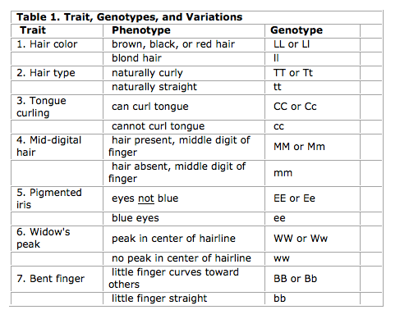
Tally Human Traits
Hair # Non blond # Blond
Do you think the more common traits are dominant or recessive? Why?
Reveal Dominant/recessive genotypes and determine your genetic # …do you have a genetic twin?
Notes:
Hair # Curly # Straight
Tongue #Rollers # Non
Finger #Mid-hair # No
Eye #Dark #Blue
Widow’s #Yes #No
Pinkie #Bent #No

Slide 21
“True Breeding populations” are created where people choose mate from ethnic group
Japan-all black haired
Sweden-all blond hair
What is more common has more to do with what genes are in the gene pool
5 fingers or 6?

Slide 22
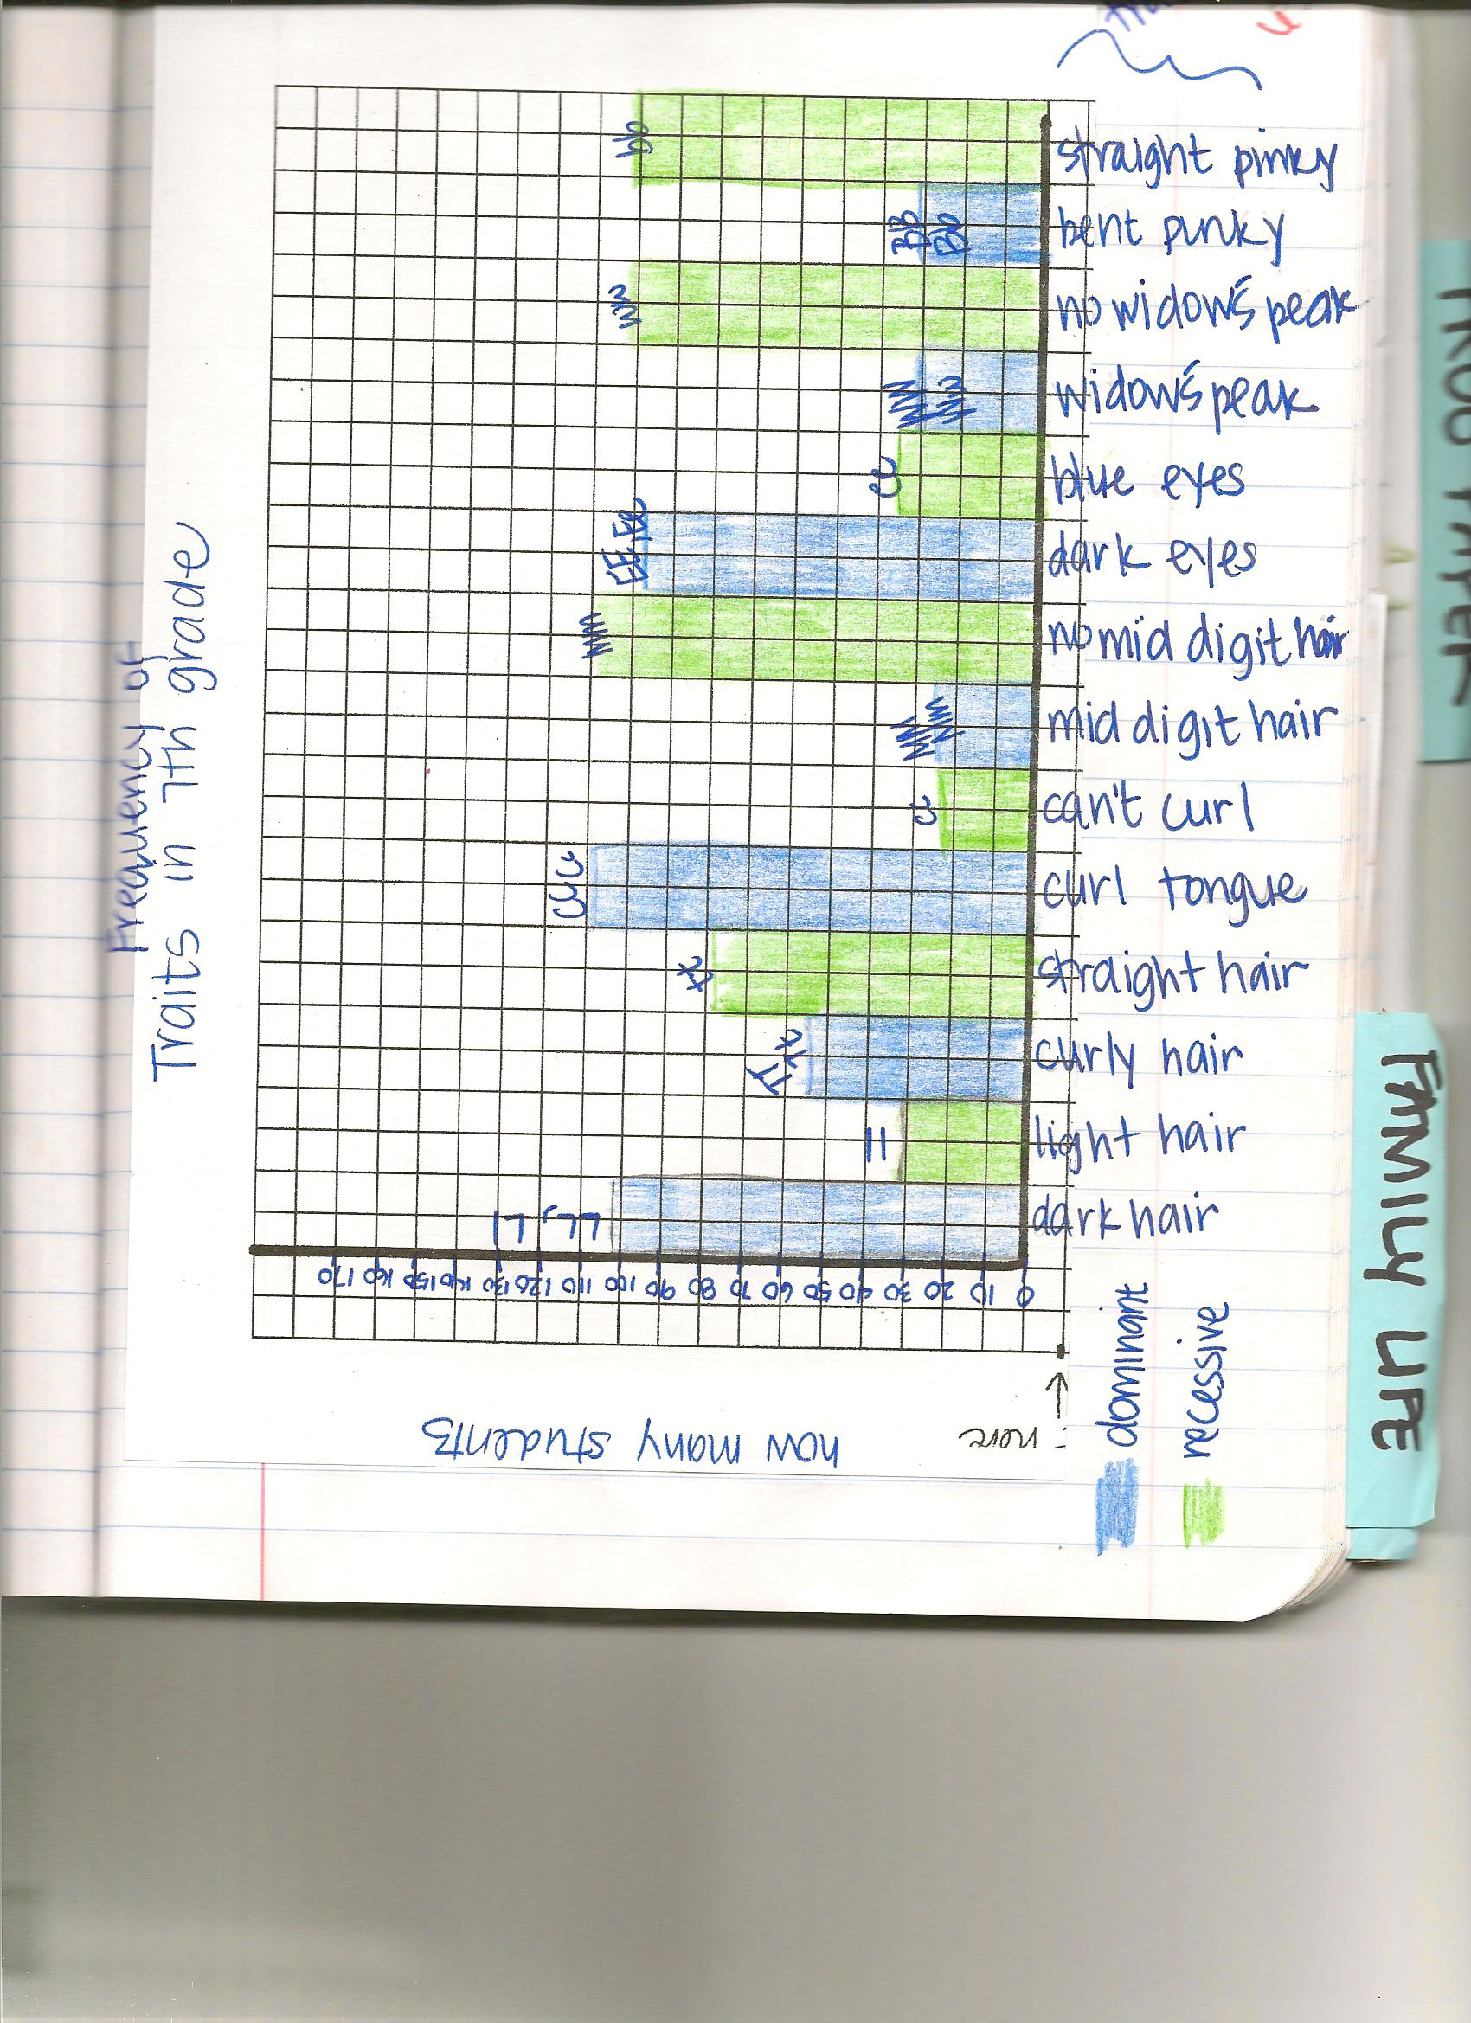

Slide 23
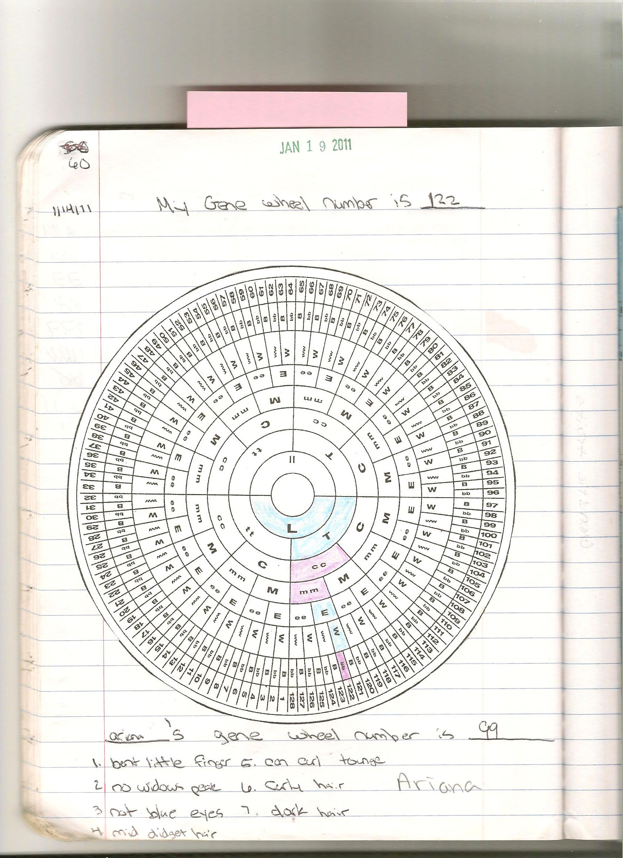

Slide 24
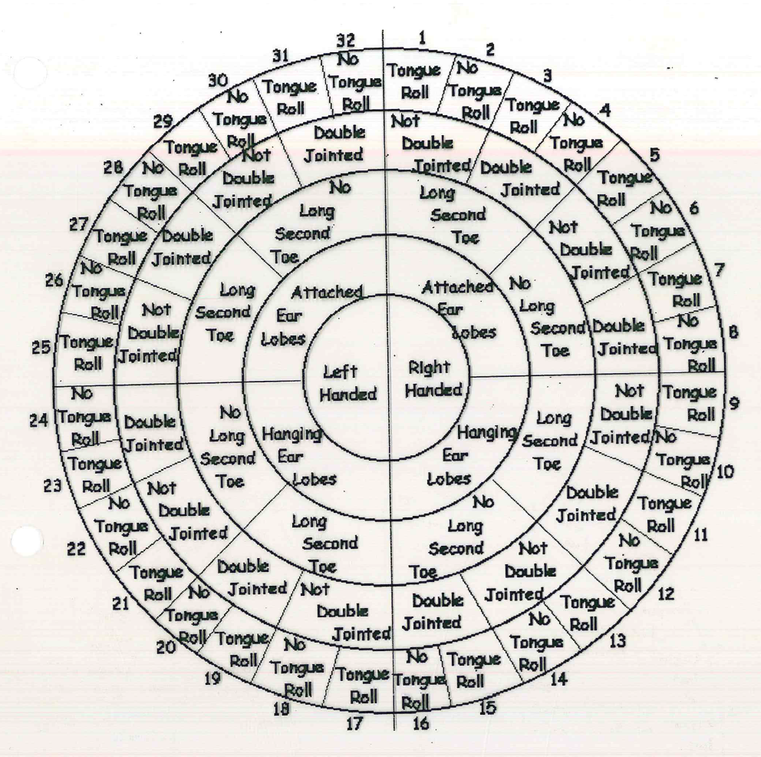
Is anyone your genetic “twin”?
Do you think common traits are dominant or recessive? Why?
Notes:
Tally the class data for each trait / alleles.
Hands # Right and # Left
etc

Slide 25
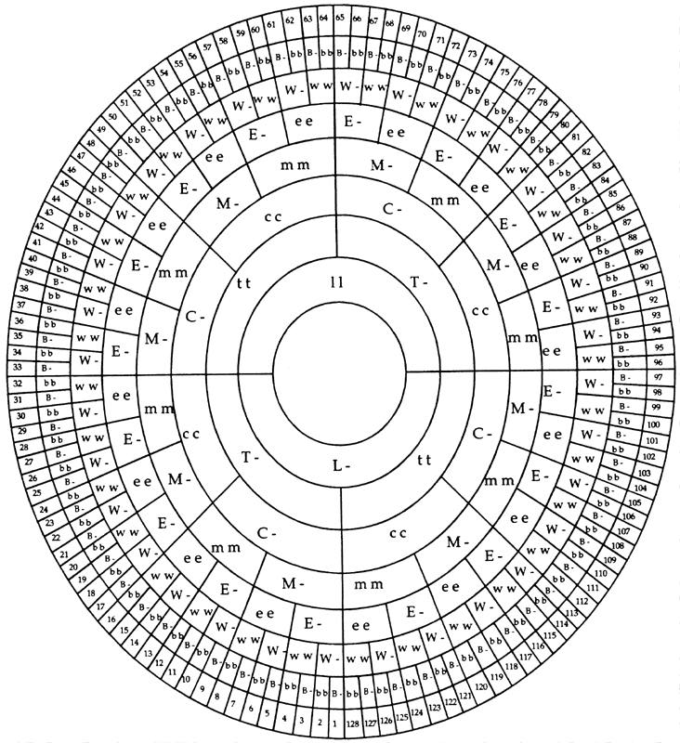
Determine your genetic # …do you have a genetic twin?

Slide 26
