Slide 1
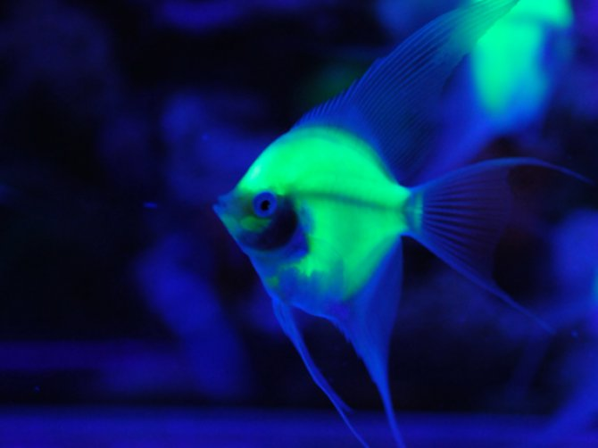
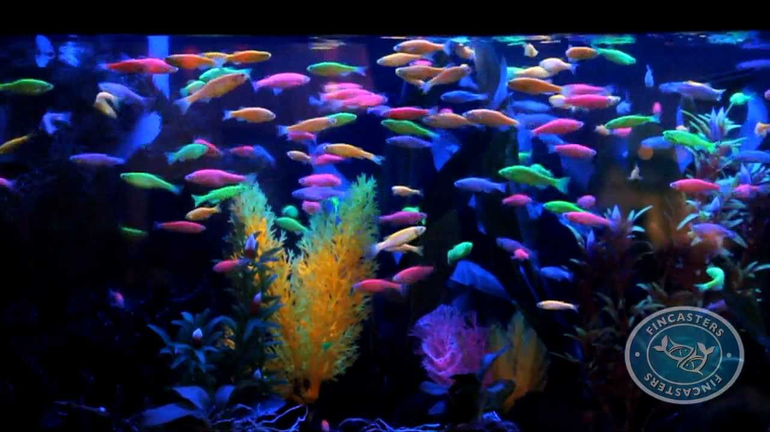
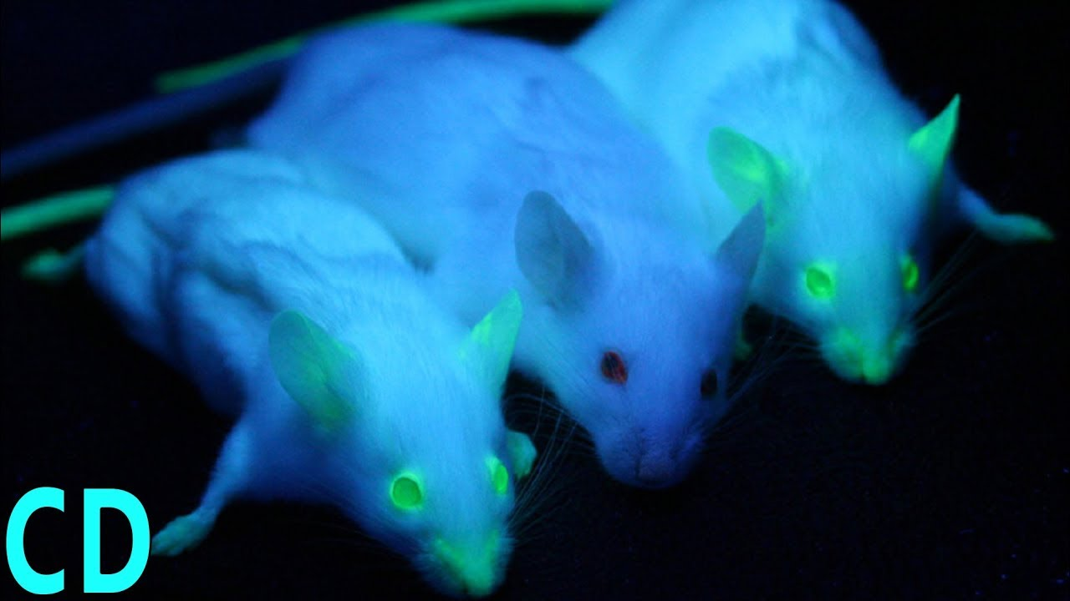
Genetic Engineering
Genetically Modified Organisms (GMO)
Recombinant Organisms
Gene Splicing

Slide 2
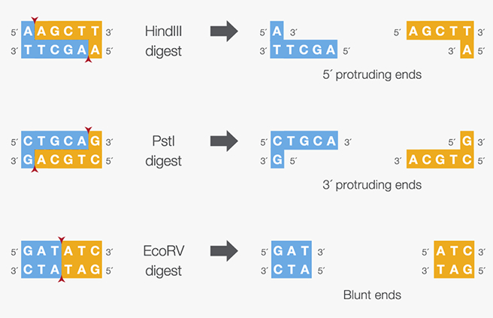
Restriction Enzyme- Protein that cuts DNA at a specific sequence, can make Sticky Ends or Blunt ends (Scissors)
5’ Sticky Ends
3’ Sticky Ends
Ligase- enzyme that can repair DNA backbone (Glue)
Blunt Ends

Slide 3
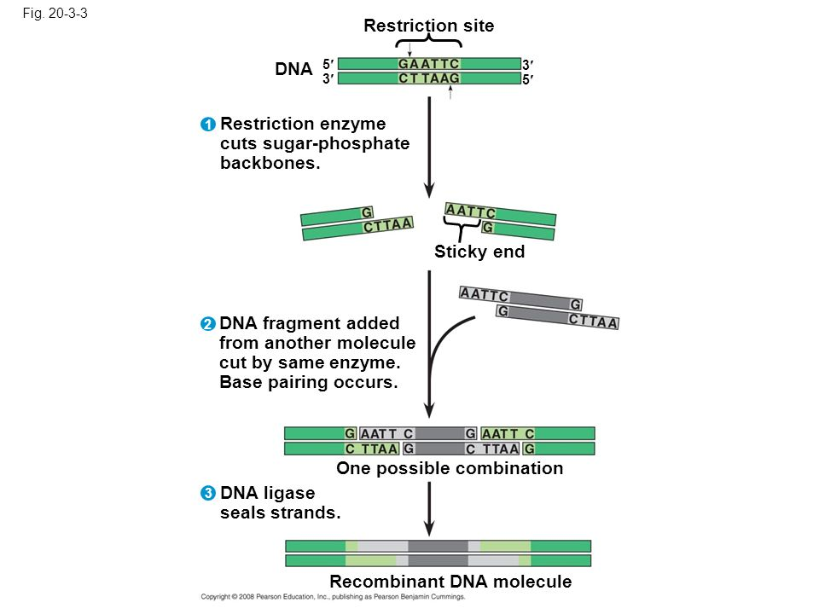
Making Recombinant DNA

Slide 4
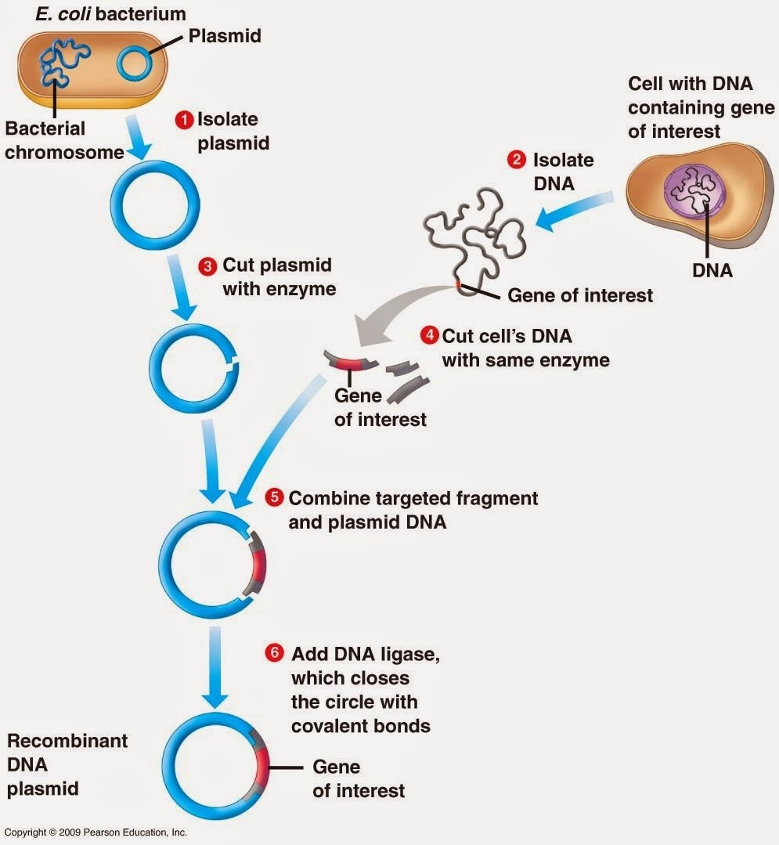
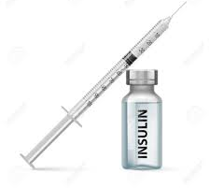
Plasmid-Circular DNA fragment that can be exchanged between bacteria to obtain traits.
Insulin-protein that regulates sugar levels in cells for energy
Isolate insulin from bacteria for human use
9
Insert plasmid with insulin gene into bacteria
Bacteria reproduce asexually by mitosis & produce insulin protein
7
8

Slide 5
Recombinant DNA-DNA with fragments from two or more species
Transgenic Organism
or Genetically Modified Organism (GMO)- organism with recombinant DNA
Human Growth Hormone and Hemophilia Blood Clotting proteins are both grown this way.

Slide 6
Template for student notes

Slide 7
9
7
8

